Slide 1


GoGreen Case Study (component 2)
By: Muhammad Arif Bin Jamaluddin
TP067696
Cloud Infrastructure & services

Slide 2

GOGREEN INSURANCE COMPANY
The main goal is to meet the client application needs for their cloud infrastructure services
The main goal is “Paperless”

Slide 3
GoGreen company profile
Company | GoGreen Insurance Company
Location | Europe, South America, Southern California
Application | CRM web application allows sales personnel to input & edit customer data. The application stores customer data, documents & convert into various formats such as images for web & mobile formats
Technical details | It has 3-tier web app that stores customer data & documents. It convert documents into various format
Goal | Is to go paperless for user data, documents & pictures

Slide 4



Current environment
Web Tier | Database tier | Application tier
6 virtual machines ( 2 vCPUs /4- GB memory) | 2 virtual machines ( 8 vCPUs / 32 GB memory/ 5.5 –TB storage) | 5 virtual servers ( 4 vCPUs /16-GB memory)
- Red hat enterprises Linux 7.5 | - Red Hat Enterprise Linux 7.5 | - Red Hat Enterprise Linux 7.5
- Apache Tomcat web service | - MySQL 5.7.22 Database cluster | - Java SRE/ Java application files
- PHP server & PHP files

Slide 5

Current issues
Issues | Solutions
On-premises & reliability issues | Impact negatively on user experience
Architecture continuously over-provisioned | To accommodate growth & performance issues
The architecture upgraded 3 times in last year | Procurement process takes 20 days Deployment takes 1 week
Costing issues | The whole process costs in excess of $100,000

Slide 6
GoGreen environment requirements
The environment includes:
Infrastructure managed by new cloud team members
Encryption for data in transit & at rest
Secured access & identify management
Stateless web servers for user connections
Baseline identified for number & type of instance required
Recovery Point Objective (RPO) for application is 4 hours
Scalability that accommodates user base growth of 90% in next 3 years
Storage for documents & pictures that must be kept 5 years. : The files are rarely requested after 3 months but infrequent access still needed
Use of managed services to improve availability & reduce costs

Slide 7
GoGreen Objective
Determine
Region, VPCs, subnets, & availability zone requirements
Design
Plan for storage & backup
Document
Implementation plan & architecture diagram
Resolve
Issue related to Web, App & Database
Document
Encryption & security details

Slide 8
Assignment workflow
Network
VPC architecture diagram
Security
Encrpytion
Instance details
Recovery Point Objective
Document storage
Web tier
Application tier
Database tier
Additional services
Proposed architecture
Cost consideration

Slide 9

Design (Network)
VPC | Region | Purpose | Subnets | AZs | CIDR Range
1 | Us-west-1 | Testing & Development | 6 | 2 | 10.0.0.0/16
2 | Eu-west-1 | Production | 6 | 2 | 10.1.0.0/16
Subnet Name | VPC | Subnet Type (Public or Private) | AZ | Subnet Address
webTierPublic1 | Both | Public | 1 | 10.0.1.0/24
webTierPublic2 | Both | Public | 2 | 10.0.2.0/24
appTierPrivate1 | Both | Private | 1 | 10.0.3.0/24
appTierPrivate2 | Both | Private | 2 | 10.0.4.0/24
databaseTierPrivate1 | Both | private | 1 | 10.0.5.0/24
databaseTierPrivate2 | Both | Private | 2 | 10.0.6.0/24

Slide 10
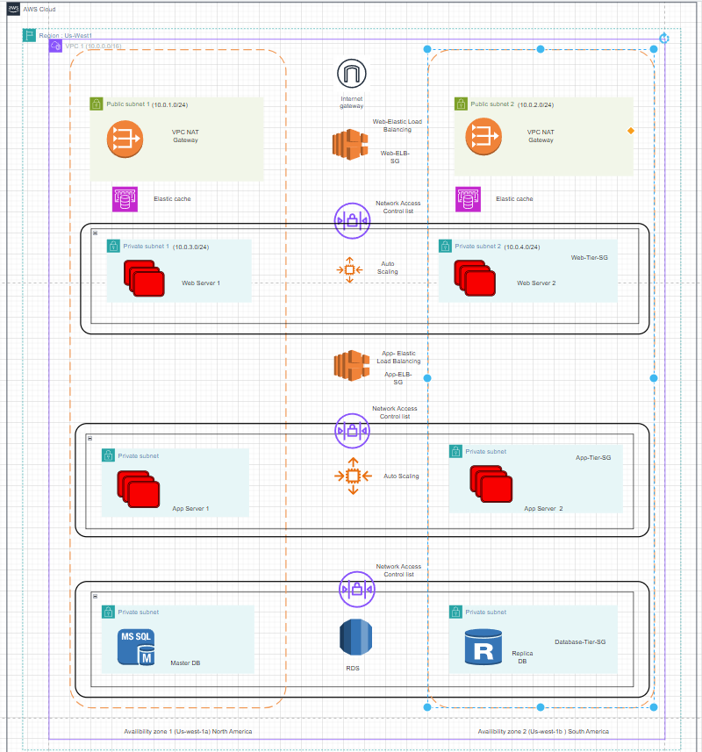
VPC architecture (VPC 1)

Slide 11
Design (Security)
Security Group | SG Name | Rule (Allowed Port) | Source
ELB Load balancer | elb_sg | Type:HTTPS , Protocol : TCP , Port Range: 443 | 0.0.0.0/0
Web tier | web_sg | Type: Custom TCP Rule, Protocol : TCP , Port Range : 8080 | Custom and specify the security group ID of Public ELB
App tier | app_sg | Type: Custom TCP Rule , Protocol:TCP, Port Range: 8080 | Custom and specify the security group ID of Web tier security group
Database tier | database_sg | Type: Custom TCP Rule, Protocol:TCP, Port Range:3306 | Custom and specify the security group ID of App tier security group

Slide 12
Other security Options | Justification
Network Security | Implement security groups and network access control lists (ACLs) to control inbound and outbound traffic between different tiers and resources within VPC.
Use IAM | Identity Access Management use least privilege access by assign roles and policies to EC2 instances
Use Distributed Denial of Service (DDoS) Protection | Use AWS Shield Standard or AWS Shield Advanced to protect from attacks web application and APIs
VPC Routing tables | To route traffic to suitable and correct locations
AWS WAF | A web application firewall that protect web from outside attackers and it allow to monitor the HTTP(S) requests

Slide 13
Design (Encryption)
Requirement | Solution
Encryption option for data at rest | Use AWS Encryption SDK with AWS KMS key created and managed in AWS KMS to encrypt data Encrypt the Amazon EBS volumes and set up Amazon S3 buckets to utilize Server-Side Encryption (SSE) with AES-256 encryption. Use Amazon RDS to supports Transparent Data Encryption (TDE)
Encryption option for data at in transit | Use encryption using protocol like Transport Layer Security (TLS) for all of the endpoints

Slide 14
Design(Instance details)
Tier | AMI | Tag | Type | Size | Justification | # of instances
Web | Amazon Linux 2 | Key: Name Value: ‘GoGreen-Web-Tier-1’ | t3 | Large | T3 instances has burstable performance to handle web traffic. It is very cost effective for moderate workloads | 6
App | Ubuntu server | Key: Name Value: ‘GoGreen-App-Tier-01’ | M5 | Large | It offers balance combination of compute and memory resources. Good to run application workloads such as microservices and web servers | 6
Database | Amazon RDS for MySQL | Key: Name Value:’GoGreen-DB-Tier-01’ | DB.R5 | 2XLarge | It is optimized for memory intensive applications where it offers memory capacity for caching | 2

Slide 15
Design (Recovery Point Objective)
Q . How to achieve Recovery Point Objective (RPO) of 4 hours?
Regular & incremental backups : Regular snapshots of data at intervals of less than 4 hours and stored in case there is a requirement for recovery
Continuous data protection : It able to capture every changes made to the data in real time or at frequent intervals
Replication : It ensures data is duplicated in real time across various locations to reduce risk of loss of data if there is disaster happened.
High availability :Implement redundant components, load balancing to minimize downtime and data loss

Slide 16
Design (Document Storage)
Storage/Archive Option | Detail
1) Amazon S3 Glacier | Provide long term archival storage data that infrequently accessed, it is very low cost and suitable to keep large volumes of data over period of times. It is perfect to store documents and pictures that required to retained for years but are accessed infrequently after 3 months It can be moved to deeper storage and deleted from the instance
2) Amazon S3 | It is very low-cost storage Suitable for data that is archived for long term where retrieval time is up to 12 hours It is ideal for storing pictures and document that need to be retained for 5 years and rarely accessed after initial 3 months

Slide 17
Web Tier Requirements
Architecture
: Must be flexible & handle peak in traffic or performance
Current Servers at 75% capacity all the time.
: The ideal is 50% to 60%
Application administrators
: Required to notified by email if there are more than 100 “ 400 HTTP errors” per minute in the application
Web tier instances
: Tagged as “Key=Name” & “Value=web-tier”

Slide 18
Design(Web tier)
Requirement | Solution
Must be flexible & handle peak in traffic or performance | Use scaling method such horizontal scaling where for web application it allows to remove and add instances depending in the volume of the web traffic
Overall acceptable incoming network bandwidth is between 300 & 700 Mbps | Use Cloudwatch alarm where notifications will be received when the bandwidth exceed 700 Mbps and fall below 300 Mbps for around 10-15 mins.
Required to notified by email if there are more than 100 “ 400 HTTP errors” per minute in the application From Application administrators | Use Cloudwatch email where alarm can be created that can trigger the number of “400 HTTP errors “ where it will trigger once it reaches over 100. The application administrators can be notified with this changes.

Slide 19
Application Tier Requirements
Architecture : Flexible & handle any peak performance
Servers: Currently at 90% of memory & CPU all the time. Server capacity should be between 50% & 60%
Memory & CPU utilization : Should not above 80% & 75% respectively or below 30%
Internet access: For patching & updates must be available without exposing servers
Application Tier : Instances should be tagged as “Key=Name” & “Value=app=tier”

Slide 20
Design(Application Tier)
Requirement | Solution
Must be flexible & handle peak in traffic or performance | Parallel or horizontal scaling where it able to handle peak demands ensuring high availability for app tier.
Overall memory & CPU utilization should not above 80% & 75% respectively or below 30% for either | Use Auto Scaling Group (ASGs) based on CloudWatch alarms where when the threshold set are met and detected by CloudWatch , autoscaling will happened. Scale out: Instances are added CPU utilization is consistently above 75% or memory utilization is above 80% Scale in : Instances are removed when CPU utilization is consistently below 30% or memory utilization is below 30%
Internet access: For patching & updates must be available without exposing servers | Deploy NAT Gateway on the public subnet VPC and allocated Elastic IP address for internet access and later update route table associated with private subnets to route the bound traffic.

Slide 21
Database Tier Requirements
Database need : Consistent storage performance at 21,000 IOPS
Ability to patch & update must be available
High availability is a requirement
Database schema can not be changed at this time

Slide 22
Design (Database tier)
Requirement | Solution
Database need Consistent storage performance at 21,000 IOPS | Use Amazon RDS where it is a provisioned IOPS SSD where it can reach consistent 21,000 for the database
High availability is a requirement | Multi AZ deployment where it replicate database across multiple Availability Zones within a region Using read replicas where to offload read traffic from the primary database instance and improve scalability and fault tolerance.
Database schema cannot be changed at this time | Implement MySQL when selecting Amazon RDS where it provides managed MySQL instances with automated backups, scaling capabilities, and monitoring features. Provides seamless transition although the schema is rigid

Slide 23
Additional services
Amazon CloudFront : Can be used to speed of web application by caching caching and delivering static and dynamic content from edge locations.
Amazon IAM : Use least privilege rules where only allow permission to necessary users by create IAM users, groups, and roles
Amazon KMS : Provide extra security data stored in Amazon S3, Amazon RDS where data encryption key can be done with KMS.

Slide 24
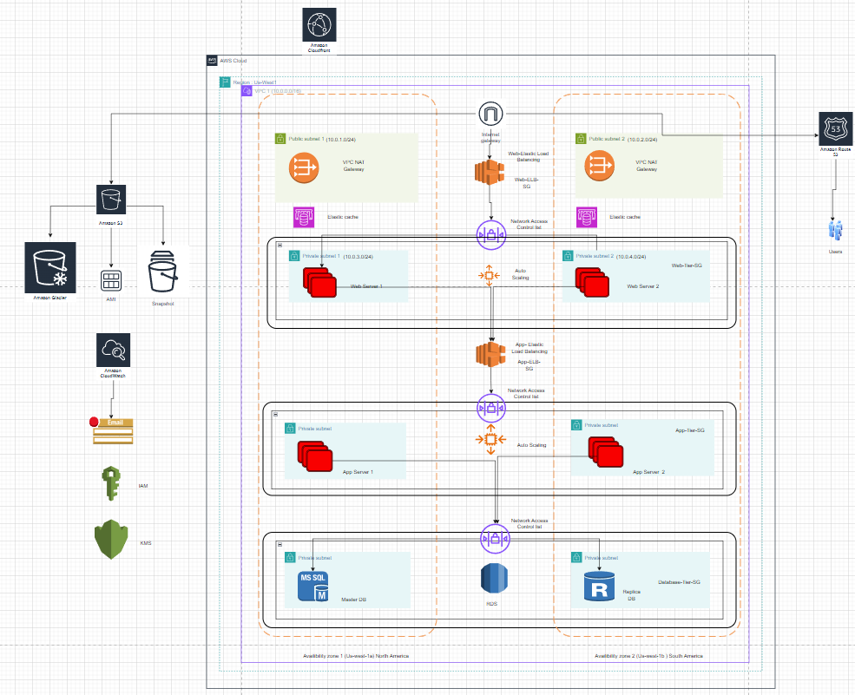
Proposed Architecture Diagram

Slide 25
Cost considerations
It used usage-based pricing where the cost are billed based on how much resources are consumed
CloudFront are charged based based on data transfer out to end-users and requests served.
IAM charges for the number of API calls made to manage IAM users and policies
KMS charges for key usage and the number of API requests to the service.
The complexity in long run cost money as it may result in administrative overhead that could impact overall cost for IAM services
Solution: Effectively manage the services efficiently and regularly monitor the usage on the AWS billing dashboard to avoid additional charges

Slide 26

Thank you

